Slide 1

Agile Methodology
Microsoft Student Partenars

Slide 2
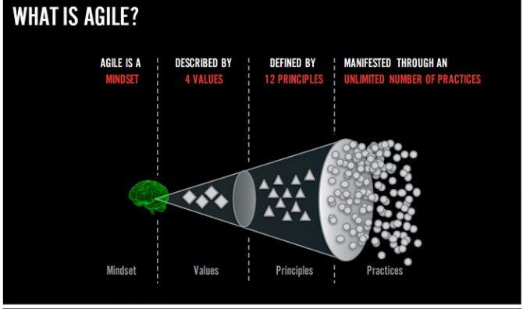
What Is Agile ?
A set of value and principles that guide how we as individuals and organizations think about and act upon the work that we do

Slide 3
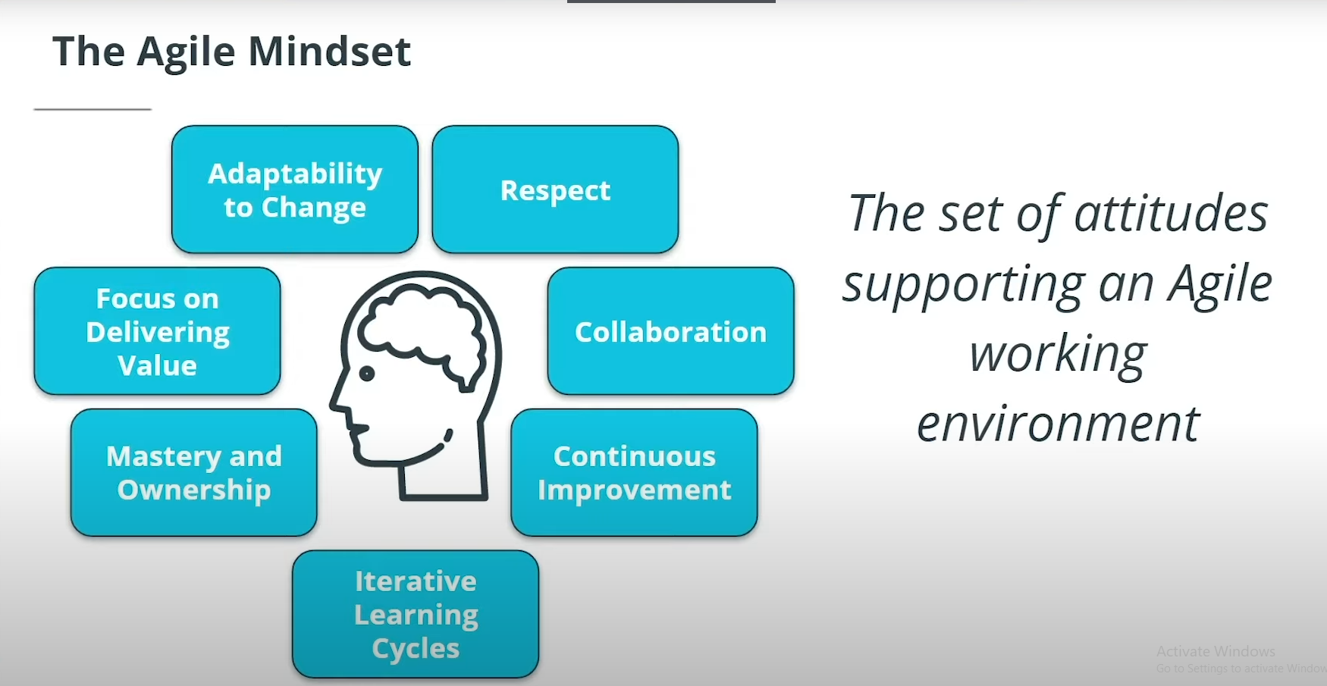

Slide 4
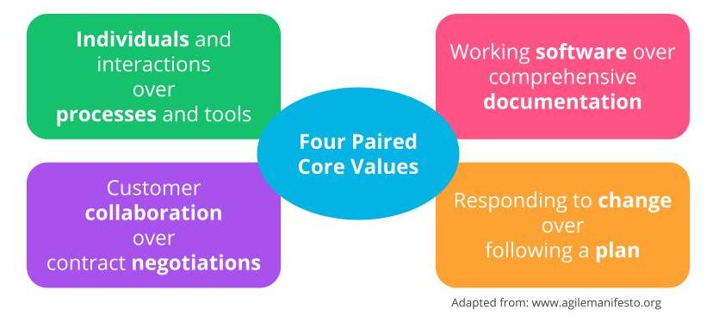
The Four Agile Core Values

Slide 5
1- Our highest priority is to satisfy the customer through early and continuous delivery of valuable software.
2- Welcome changing requirements, even late in development. Agile processes harness change for the customer's competitive advantage.
3- Deliver working software frequently, from a couple of weeks to a couple of months, with a preference to the shorter time scale.
4- Business people and developers must work together daily throughout the project.
5- Build projects around motivated individuals. Give them the environment and support they need, and trust them to get the job done.
6- The most efficient and effective method of conveying information to and within a development team is face-to-face conversation.
The Agile Manifesto Principles

Slide 6
7- Working software is the primary measure of progress.
8- Agile processes promote sustainable development. The sponsors, developers, and users should be able to maintain a constant pace.
9- Continuous attention to technical excellence and good design enhances agility.
10- Simplicity - the art of maximizing the amount of work not done - is essential.
11- The best architectures, requirements, and designs emerge from self-organizing teams.
12- At regular intervals, the team reflects on how to become more effective, then tunes and adjusts its behavior. (Retrospective meetings)
The Agile Manifesto Principles

Slide 7
Scrum Famerwork
Scrum is by far the most common Agile Framework.
The features are delivered in iterations known as Sprints.
Scrum employs an iterative approach to control risk.
Knowledge comes from experience over time.

Slide 8
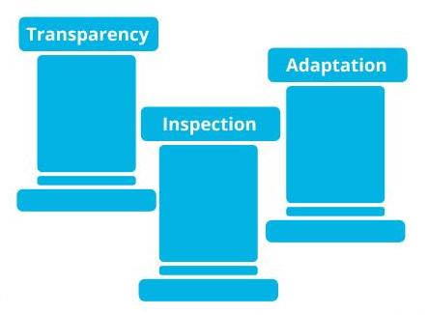
Scrum Pillars

Slide 9

Scrum Values

Slide 10

Thanks For Your Attention

